Slide 1
Ad Knowledge Music Company
Sravan Kumar(16221049)
Architha Mukka(16221229)
Vikesh Padarthi(16221783)
Manikanta (16209576)

Slide 2
ABSTRACT
This music company helps owners to rent their audio rooms effectively. In this application, user will be prompted to login with details and can select audio room. After selecting a audio room, user can book a date of their necessity using calendar pop-up. Next, user navigates to a page of slots and allows to make an appointment. After making an appointment, user has to wait to know the status of approval from the owner of the company. Communication is done via E-Mail.

Slide 3
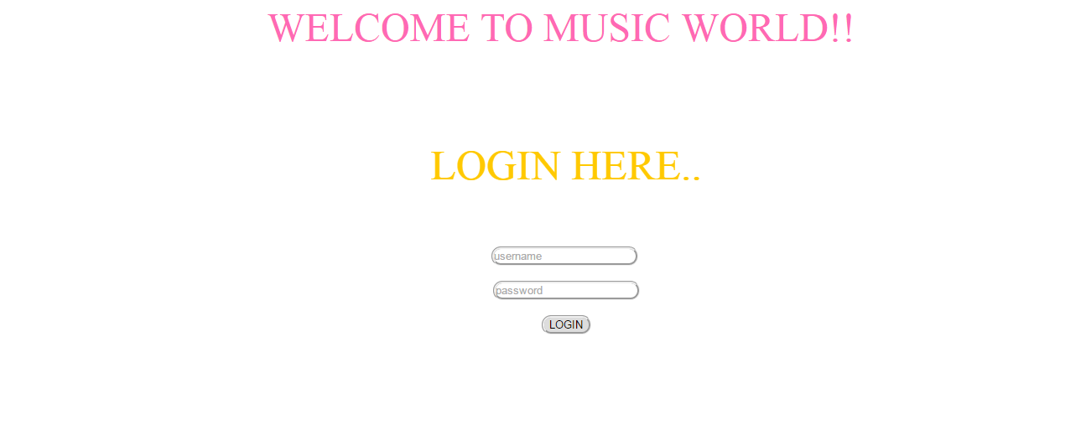
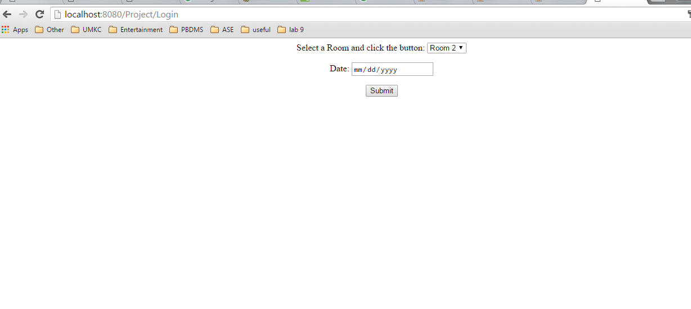
Login Screen
RR R
Room and Date Selection

Slide 4
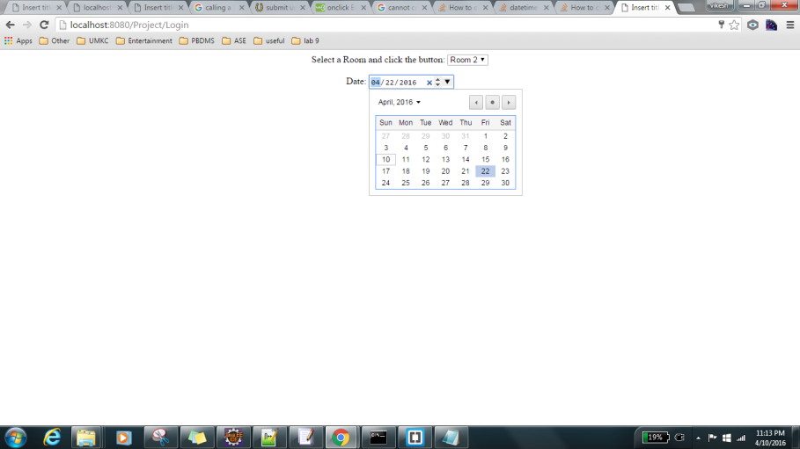
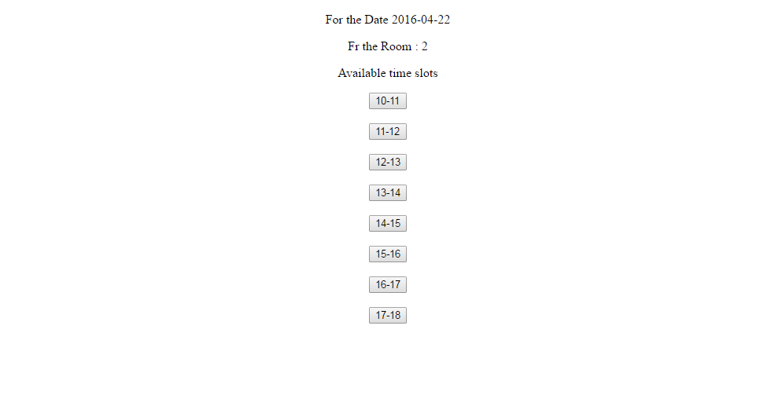
Time Selection
Time Slot Confirmation

Slide 5
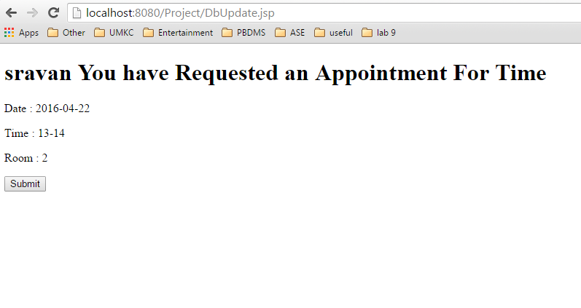
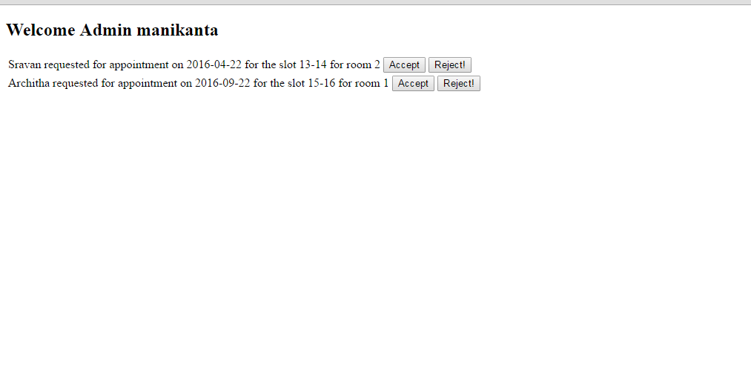
Appointment Confirmation
Admin Confirmation

